Slide 1
SEQUENCE
Data warehouse & Olap
What is the data warehouse
The data warehouse process
Modeling of data warehouse
What is Olap
tools for data warehouse

Slide 2
Data warehouse
structured for query and analysis
build warehouse help to make decisions
allow for fast answers to queries
the design of data warehouse database is a blend of technologies( OLAP, MOLAP ,Star schema,Snowflacke schema …)
the information in a warehouse to spot and trends relationships.

Slide 4
Data Warehousing
Data sources often store only current data, not historical data
Corporate decision making requires a unified view of all organizational data, including historical data
A data warehouse is a repository (archive) of information gathered from multiple sources, stored under a unified schema, at a single site
Greatly simplifies querying, permits study of historical trends
Shifts decision support query load away from transaction processing systems

Slide 5
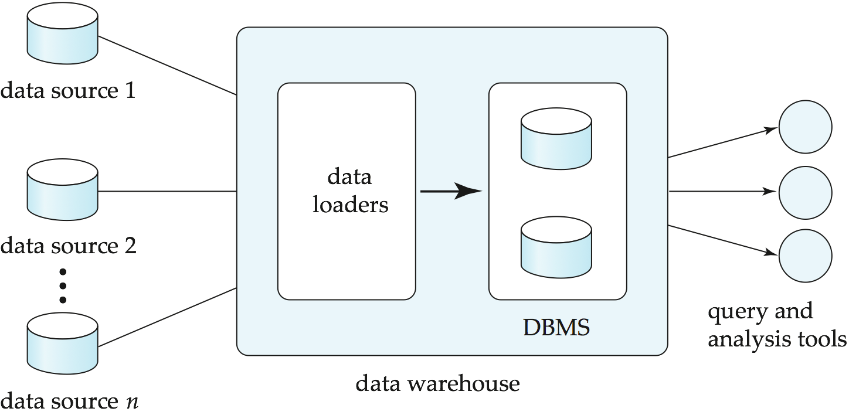
Data Warehousing

Slide 6
Data warehouse

Slide 7
The different between OLTP database an data warehouse
Online transaction processing
Queries can access many rows per table | Queries can access single row at a time per table
Supports few concurrent users | Supports thousands of concurrent users

Slide 8
Data mart
A data mart is simply smaller data warehouse .
Usually the data in a data mart is subset of data that is found in an enterprise-wide data warehouse
Faster query ,because there is less data against which to query
Fewer users competing for resources
Faster deployment time

Slide 9
Data warehouse life cycle and process

Slide 11
Data transformation
Data transformation is the process of formatting and modifying data that extracted from various sources to make the information more useful in the data warehouse ,when you transform data ,you may want to change the format of data ,combine data, or calculate data

Slide 12
validation
Extracting data from operational systems and loading it into a data warehouse or data mart ,the source data that you provide to data warehouse must be accurate ,stable and consistent ,verifying the accuracy and correctness of data is called( validation)

Slide 13
OLAP TECHNIQUE

Slide 14
OLAP TECHNIQUE
OLAP tools must be able to do the following:
Support multiple dimension and hierarchies within a dimension
Aggregate , summaries, pre-calculate and derived data along single dimension or set of selected dimensions
Support the concept of business model – define relationship in a set of selected dimensions ,calculation logic, analytical routines and summarized data
Provide powerful calculations and comparative functions like ranking, comparisons, maximum and minimum , average and moving averages

Slide 15
OLAP operations
1.Roll up( summaries the data)
2.Drill Down( refining data into narrower views)
3.Slicing & Dicing( projection of data)
an estimate or forecast of a future situation or trend based on a study of present ones.

Slide 16
OLAP cube

Slide 17
Cube levels
Cube members

Slide 18
Measure

Slide 19
Modeling

Slide 20
Modeling components

Slide 21
Modeling techniques
star schema

Slide 22
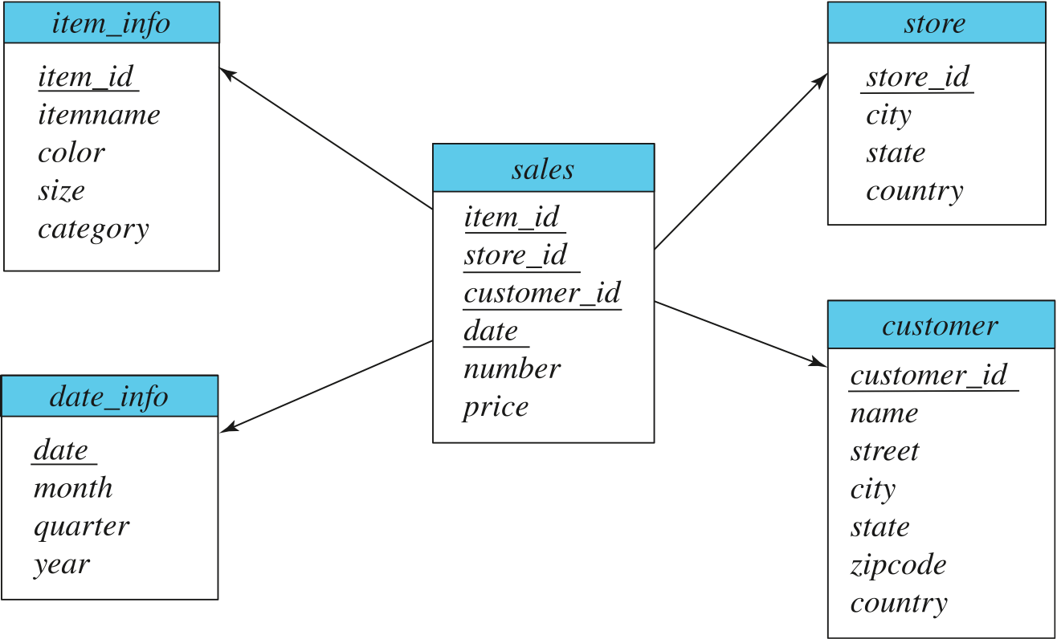
Data Warehouse Schema

Slide 23
Component of star schema
a. Fact table

Slide 24
Component of star schema
b. Dimensions table

Slide 25
Conventional Dimensions

Slide 26
Conventional Dimensions

Slide 27
Current system

Slide 28
Current system
The division of the export
It is responsible from the requirements of exports
The division of the import
It is responsible from the coming containers from abroad
The division of permission of delivering
It is responsible from organization of delivering operations
The division of warehouse
It is responsible from delivering of emptied containers

Slide 29
Warehouse Schemas
Dimension values are usually encoded using small integers and mapped to full values via dimension tables
Resultant schema is called a star schema
More complicated schema structures
Snowflake schema: multiple levels of dimension tables
Constellation: multiple fact tables

Slide 30
Current system
Current system tables

Slide 31
Current system

Slide 32
analysis

Slide 33
Design
I used star schema technique that contents
a. fact table (shipfact).
b. 3 dimensions table (timedim ,typedim, activitydim)

Slide 34
PIL DATA WAREHOUSE TABLES
shipfact

Slide 35
PIL DATA WAREHOUSE TABLES
Time dimension

Slide 36
PIL Data Warehouse Star Schema

Slide 37
PIL DATA WAREHOUSE TABLES PROCESS
I used DST in SQLserver2000 to populate the data warehoue

Slide 38
PIL DATA WAREHOUSE CUBE

Slide 40
conclusion
1. Data warehousing is not a new phenomenon. All large organizations already have data warehouses, but they are just not managing them. Over the next few years, the growth of data warehousing is going to be enormous with new products and technologies coming out frequently. In order to get the most out of this period, it is going to be important that data warehouse planners and developers have a clear idea of what they are looking for and then choose strategies and methods that will provide them with performance .
2. In this first project it achieved the basic data warehouse process and goals from determining the key PIL information that PIL management wants to keep it in the data warehouse ,extract , transform and load source data and push this information to the PIL data warehouse ,at last the solution offers reports samples that helpful to decision –maker about the PIL historical data

Slide 41
conclusion
3.The project provides more flexible and reliable reports(using OLAP tools),PIL warehouse manages to has multidimensional information that outperforms the optimal static view selection especially for activities that include a lot of roll-up queries, the performance of PIL system is even better

Slide 42
Recommendations

Slide 43
thank you

